Slide 1

AMRITA SCHOOL OF ARTIFICIAL INTELLIGENCE, BENGALURU
B. Tech in Artificial Intelligence and Data Science (AID)
Second Semester, Section F, Academic Year: 2023-24
ELEMENTS OF COMPUTING - 2 (23AID113)
END-TERM PROJECT REPORT
On
Tic Tac Toe
Presented by
Valluri Veera Gangadhara Sai Teja

Slide 2
Contents
Overview (About the Game)
Game Layout
How to Play
File details
Block Diagram/Flow Chart
Objectives
Implementation details
for objective 1
for objective 2
for objective 3
for objective 4
Challenges Faced
Limitations/Bugs
Future Work
Gameplay (demo)
References

Slide 3
Overview (about the game)
Tic Tac Toe, also known as noughts and crosses, is a classic paper-and-pencil game typically played on a 3x3 grid. The game involves two players, usually represented by "X" and "O", taking turns marking spaces in the grid with their respective symbols. The objective is to create a line of three of your symbols either horizontally, vertically, or diagonally.
Explore the features and syntax of Jack Language. Understand how to implement the Tic Tac Toe game using Jack. Learn about the unique aspects of Jack that make it suitable for game development.
While the traditional game is played on a 3x3 grid, there are variations with larger grids (4x4, 5x5, etc.) that provide additional complexity and opportunities for strategic play. There are also variations where players play multiple rounds, with the winner being the first to win a certain number of rounds.

Slide 4
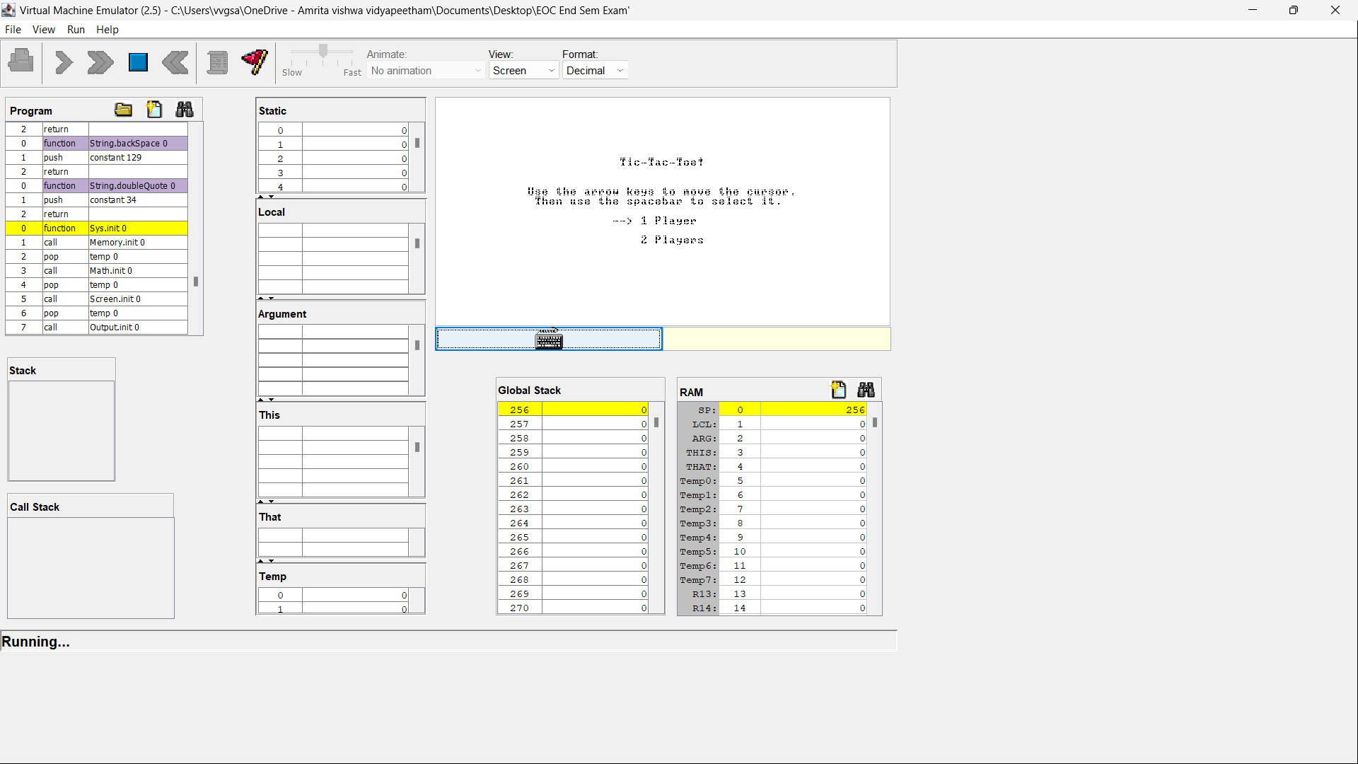
Game layout
Game in
Hack screen
VM Emulator
Fig. 1: Game in VM Emulator

Slide 5
How to play
We will get a 3x3 grid board we call it as Tic Tac Toe board
Decide which player will be "X" and which will be "O". Players usually take turns being "X" and "O" in successive games.
The player who is "X" typically starts the game.
Players take turns placing their symbol ("X" or "O") in an empty cell of the grid.
Each player can only place one symbol per turn.
The game continues until one player achieves a winning pattern or the grid is full.
A player wins the game if they successfully place three of their symbols in a row, column, or diagonal.
The winning patterns can be :
Horizontal: Three symbols in a row on the same horizontal line.
Vertical: Three symbols in a column on the same vertical line.
Diagonal: Three symbols in a diagonal line from one corner to another.

Slide 6
File details
Main. Jack:
This function initializes the program, creates an instance of the 'Tic-tac-toe' game, runs the game, and then cleans up resources before terminating.
It creates a new instance of the Tic-tac-toe game by calling the Tic-tac-toe. New method with no arguments. The instance is stored in a local variable (local 0).
It calls the Tic-tac-toe. Run method on the newly created Tic-tac-toe instance, possibly passing an argument. This method likely starts the game loop or initiates gameplay.
After the game execution completes, it calls the Tic-tac-toe. Dispose method on the Tic-tac-toe instance to clean up any resources used by the game.

Slide 7
Random. Jack:
In a Tic Tac Toe game where a player is playing against the computer, the Random file might be utilized to enable the computer player to make random decisions or to introduce an element of randomness into the computer's decision-making process.
When it's the computer player's turn to make a move, it may utilize the Random.randRange function to randomly select an empty cell on the game board to make its move. This adds unpredictability to the computer's moves, making the gameplay more challenging and less predictable for the human player.
In more advanced implementations, the computer player might use randomness to decide between multiple possible moves of equal strategic value. For example, if there are multiple winning moves available, the computer might randomly choose one instead of always picking the same one, creating variability in its gameplay.

Slide 8
Array. Jack:
The Array file seems to be part of a larger system that manages memory allocation and deallocation.
It provides basic functionality for handling dynamic arrays.
The new function ensures that arrays are only created with a valid size, preventing issues like zero-sized arrays.
The dispose function ensures that memory allocated for arrays is properly released when it's no longer needed, helping to prevent memory leaks.
Board. Jack:
Allocates memory for a new game board
Initializes various attributes such as the current row and column, cursor position, and markers for X and O.
Draws the game grid with horizontal and vertical lines.

Slide 9
Cursor. Jack:
Allocates memory for a new Cursor object.
Initializes the x and y coordinates of the cursor.
Draws a cursor shape based on its current position (x and y coordinates).
Keyboard. Jack:
Reads an integer value from the keyboard input.
Utilizes Keyboard.readLine to get a string input.
Converts the string input to an integer using String.intValue.
Returns the integer value.
Checks if a key is currently pressed. It does so by peeking at the memory address 24576, which is commonly used to store keyboard input status.
Initializes the keyboard. This method doesn't perform any specific action in this implementation.

Slide 10
Math. Jack:
Determining winning conditions: The Math file can contain functions to check for winning combinations of X's and O’ s on the game board.
Detecting draws: Functions in the Math file could help identify when the game ends in a draw if there are no winning combinations and the board is full.
Validating moves: It can include functions to verify whether a player's move is legal or not based on the current state of the board.
Memory. Jack:
In a Tic Tac Toe game, the Memory file might be used to manage memory allocation and deallocation efficiently
Storing game board state: The Memory file can allocate memory dynamically to store the current state of the Tic Tac Toe board, allowing the board to expand or shrink as needed during gameplay.

Slide 11
Menu. Jack:
Displaying the main menu: The Menu file can handle displaying the main menu when the game starts, presenting options like 1 player or 2 player
OMarker.Jack:
In Tic Tac Toe, the "OMarker" likely refers to the representation of the O symbol, which is one of the two symbols used in the game to mark the cells on the board
The OMarker class would likely contain methods to draw the O symbol on the game board. This could involve rendering the O symbol using graphics or text in the appropriate cell on the board
XMarker.Jack :
In Tic Tac Toe, the “XMarker" likely refers to the representation of the X symbol, which is one of the two symbols used in the game to mark the cells on the board
The XMarker class would likely contain methods to draw the Xsymbol on the game board. This could involve rendering the X symbol using graphics or text in the appropriate cell on the board

Slide 12
Output.Jack:
Displaying the Game Board: The output file is responsible for rendering the game board visually, showing the current state of the game to the players. It presents the grid where X's and O's are placed, indicating the positions of the marks
Showing Game Messages: It displays messages to the players during the game, such as prompts for player input, notifications of game outcomes (win, draw, or loss), and any other relevant information like whose turn it is.
Screen.Jack:
The screen file is responsible for rendering the game board on the screen or display device. It translates the logical representation of the game board into actual pixels on the screen, ensuring that players can see the current state of the game.
The screen module may include features to support scalability, allowing the game board to adapt to different screen sizes and resolutions, ensuring optimal display on various devices.

Slide 13
String.Jack:
The String module may be used to store and manipulate the names of the players in the game. It provides functions for initializing, updating, and displaying player names on the screen.
String manipulation is often necessary for displaying various game messages, such as prompts, notifications, or victory messages, to the players during different phases of the game.
Sys.Jack:
The Sys module may be used for error handling and reporting. In case of critical errors or exceptional conditions during the game execution, the Sys module provides functions for displaying error messages and terminating the program gracefully, ensuring a better user experience.
The Sys module can be used to read and write configuration files or settings, allowing players to customize game options such as difficulty level, sound settings, or control preferences.

Slide 14
TicTacToe.Jack:
This file is the main file to run the game in this file we have written Instance Variables, Constructor, Dispose Method, Draw Method, Clear Input Area Method, Take Input Method, Over Method, Switch Player Method, Run Method.
‘Player’ : Represents the current player (either 'X' or 'O’).
‘Board’ : An array representing the game board. Each element of the array corresponds to a cell on the board, initially set to empty (' ').
‘last Index’ : Represents the index of the last move made on the board.
‘Board’ : An instance of the Board class, used for graphical representation of the game board.

Slide 15
Block diagram/Flowchart
Menu Screen
Player 1 turn
No
If no empty spaces
TIE
Player2 | Player1
Winner? | Winner?
Yes
Winner Screen!
No
Player 2 turn
Fig. 2: Flow chart for Tic-Tac-Toe Game

Slide 16
Objectives
Objective 1:Starting we have implemented Tic-Tac-Toe-2 player mode in java language
Objective 2:Referred and modified Tic-Tac-Toe 1 player game in jack language and convert in VM code and executed in VM Emulator.
Objective 3:Referred and modified Tic-Tac-Toe 2 player game in jack language and convert in VM code and executed in VM Emulator.
Objective 4:Now we have combined all the 1 player files and 2 player files which we have done in the jack language , and we have created menu in the staring of the game that is if player want to play with computer he can choose 1 player mode. If the player want to play with his friends then he can choose the 2 player mode.

Slide 17
Implementation details
For objective 1:
First, I developed a Tic Tac Toe game in Java, initially supporting only the two-player mode. However, I later conceived the idea of enhancing the game to include both one-player and two-player modes
For objective 2:
Initially, I implemented the one-player mode by leveraging existing Tic Tac Toe files from GitHub. These files, written in the Jack language, included a "random" file, crucial for enabling the computer to place its mark randomly. In the one-player mode, the main file is the "random" file, as it dictates how the computer places its mark on the board

Slide 18
For objective 3:
For the two-player mode, I utilized Tic Tac Toe files also obtained from GitHub, written in the Jack language. I translated these Jack files into VM code and executed the code using a VM emulator, allowing me to play the game in two-player mode
For objective 4:
Using my methodology, I integrated the files from both the one-player and two-player modes. Additionally, I created a menu interface to prompt the player to choose between playing against the computer or playing with a friend, effectively implementing the two modes of gameplay

Slide 19
Challenges faced
When we are trying to convert Jack code to VM code then in the array we have faced an issue that is “Expected a type followed by comma-separated variable names” and later on we taken help of google and AI tools then we did a syntax issue in the new function of the Array class
After converting the Jack code to VM code the if I load the file in the VM Emulator the we got illegal 16 bit error we have taken help of Ritesh sir and we go through the code and the error is because of it is more then 16 bit so we convert it to the 16 bit value and we have solved the problem

Slide 20
Limitations/Bugs
After completing a match in the game, there's currently no automatic reset functionality. To start a new match, the code in the VM Emulator needs to be reset manually. If players wish to play another match, they must rerun the code from the beginning.
In your game's win detection mechanism where errors in checking the board for winning patterns may occur, leading to inaccurate or incomplete recognition of winning configurations. It emphasizes the importance of thorough testing, debugging, and refining algorithms to ensure accurate win detection and enhance gameplay experience

Slide 21
Future Works
We are planning to create a function that will automatically restart the match after it has been won or drawn. This function is intended to enhance the user experience by seamlessly transitioning from one match to the next without requiring manual intervention.
We are considering implementing different difficulty levels in the 1 player mode of our tic-tac-toe game to provide players with varying levels of challenge. Currently, we have a single-player mode where the computer makes random moves, but we want to enhance the gaming experience by offering players the option to choose between different difficulty levels: hard, easy, and moderate.

Slide 22
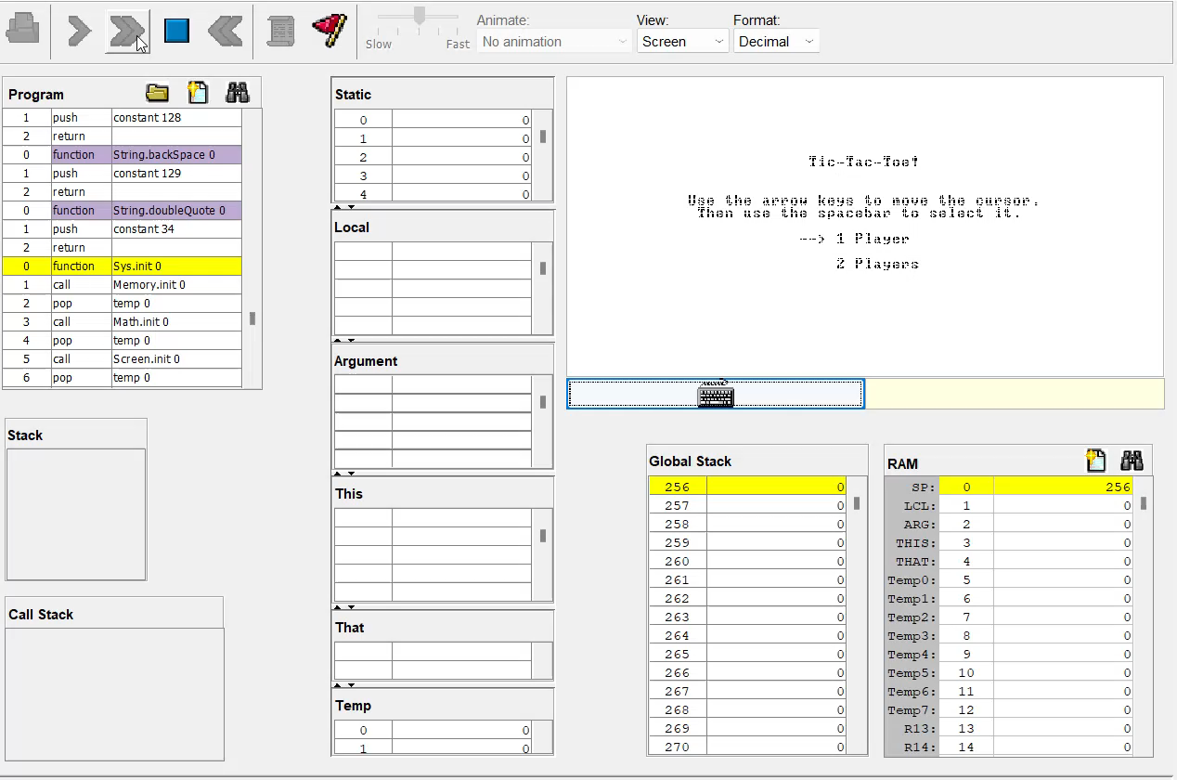
Gameplay (demo)

Slide 23
References
[1] https://github.com/jaysonjc/tictactoe-jack
[2] https://youtu.be/1picbaxgVfA?si=Kj1ighR28DvdiyTf
[3] https://github.com/juxtin/tic-jack-toe
[4] https://www.youtube.com/watch?v=rA7tfvpkw0I&t=30s&pp=ygUYdGljIHRhYyB0b2UgZ2FtZSBpbiBqYXZh
[5] GitHub - Karthikeya22/TicTacToe-Using-Jack-Language

Slide 24
Thank you

